Slide 1
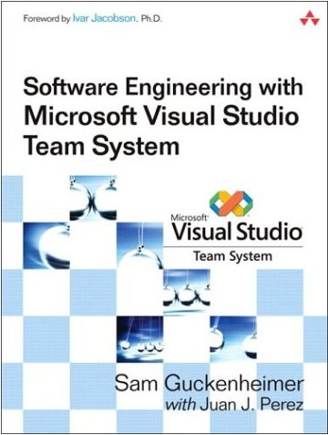
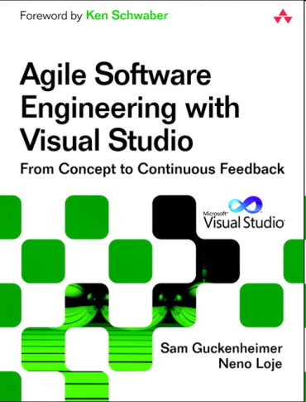
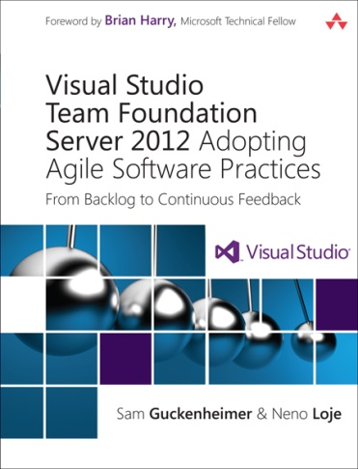
From Agile to Cloud Cadence
thoughts to share from Microsoft Developer Division’s Transformation to DevOps
Sam Guckenheimer
Product Owner, Visual Studio Product Line Microsoft Corporation
@samguckenheimer
@shitsamgusays

Slide 2

Usage culture
Pierre-Auguste Renoir, Luncheon of the Boating Party

Slide 3
Adopting Cloud Cadence
The Why?
Teams
Schedule
Ceremonies
Deployment
Practices
Live Site Culture
Business Success
Telemetry
Learning
Productizing

Slide 4
Adopting Cloud Cadence
The Why?
Teams
Schedule
Ceremonies
Deployment
Practices
Live Site Culture
Business Success
Telemetry
Learning
Productizing

Slide 5

A DevOps Lifecycle
Usage should determine the next set of priorities and learning
Availability and performance issues are hard to troubleshoot in this fast-changing world with distributed applications
BACKLOG
Development
Production
Collaboration
The agile methodologies are accelerating the construction process
An automated release pipeline is needed to deliver at the pace of development with full traceability
Notes:
What is driving DevOps?
The agile methodologies are accelerating the construction process and creating a significant pressure to Operations teams to update their existing practices to make enable faster cadence, in other words changing and adopting existing process to not only be reliable but also support and agile cadence.
In our internal teams and with some of our enterprise customers we noticed that once a team is able to accelerate the construction phase consistently. The next evolution process is to ensure such applications remind available and performing as expected. And when they aren’t having access to information and tools that allow both Operations and development teams to diagnostic and fix issues quickly.
Then these teams become more sophisticated and mature and then they want to have access to customer usage information to use quantitative and qualitative data to help them determine the next set of investments and enable continuous learning.

Slide 6
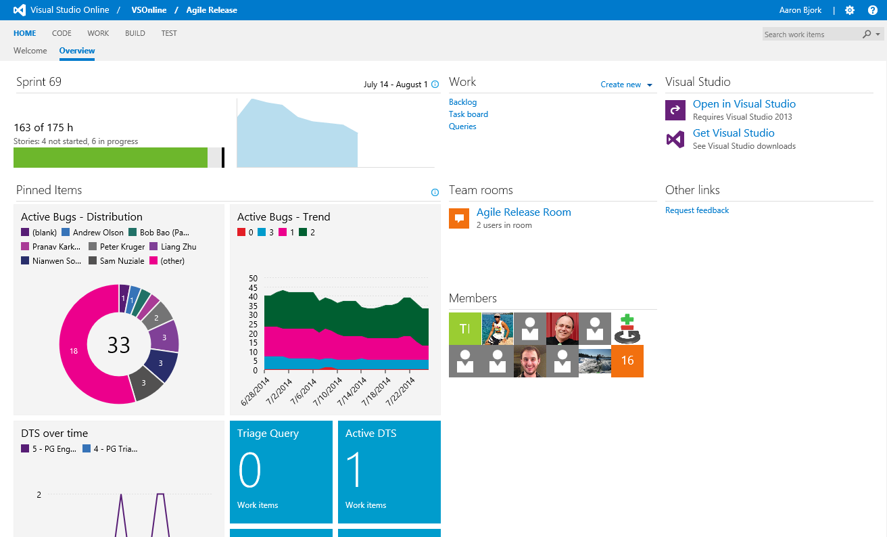
Example: VSOnline evolves features that are later shared with on-prem

Slide 7
Adopting Cloud Cadence
The Why?
Teams
Schedule
Ceremonies
Deployment
Practices
Live Site Culture
Business Success
Telemetry
Learning
Productizing

Slide 8
Scrum Teams (a.k.a. “Feature Crews”)
Cross-discipline
8-12 people
Led by their triad
Intact for 12-18 months
Autonomous backlog
Sample Area:Version Control
Notes:
These teams are cross-discipline and have a fair amount of autonomy over an area of the product. Each team has a PM, Dev Lead, and Test Lead. They represent a “triad” which is the decision making body of the team.
Could touch on Dan Pink’s book Drive here
Autonomy
Mastery
Purpose

Slide 9
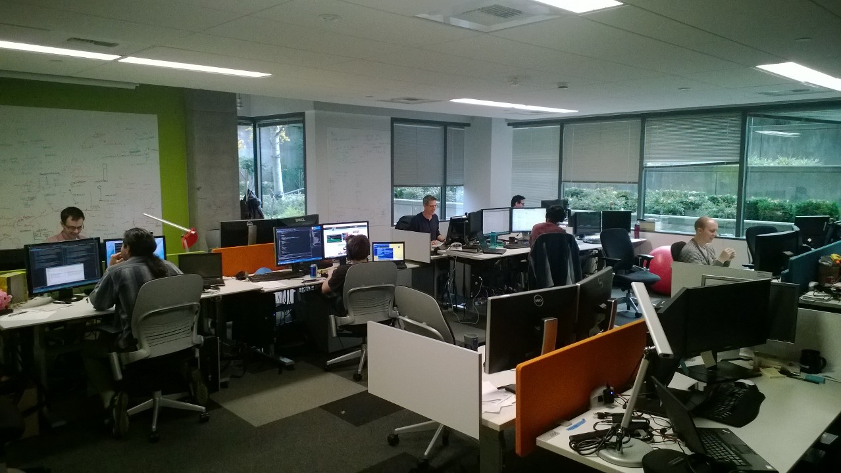
Team Rooms

Slide 10
Adopting Cloud Cadence
The Why?
Teams
Schedule
Ceremonies
Deployment
Practices
Live Site Culture
Business Success
Telemetry
Learning
Productizing

Slide 11
Planning Horizons
Sprint
3-week sprints
Planning Chat
3 sprints
Season
6 month season
Vision
18 month vision
3
3
6
18
3
Notes:
I want to start with the punch line and just tell you the basics. This is how we run our teams:
3 week sprints
6 month planning “seasons” (Spring & Fall) – usually you can make a Seattle joke here.
18 month vision
We never deviate from this cycle. It’s continuous.

Slide 12
3 Week Sprints
Deployment
Sprint Planning
Done Done!
Week 1
Week 2
Week 3
Sprint 56
Sprint 57
Sprint 58
Week 1
Week 2
Week 3
Week 1
Week 2
Week 3
Notes:
The sprints are traditional Scrum sprints. Teams do sprint planning on day 1 of week 1. We’re done at the end of the 3rd week. And then we rinse and repeat. And we deploy live to our service 1 week after the sprint wraps up. I’ll talk more about that later…

Slide 13
Low Ceremony - Sprint Mails and Video
The sprint plan
What we accomplished
Week 1
Week 2
Week 3
Sprint 56
Sprint 57
Sprint 58
Week 1
Week 2
Week 3
Week 1
Week 2
Week 3
Notes:
Another way we keep in touch is through what we call “sprint mails”. Every sprint teams send two mails:
Sprint Kickoff
Sprint End

Slide 14
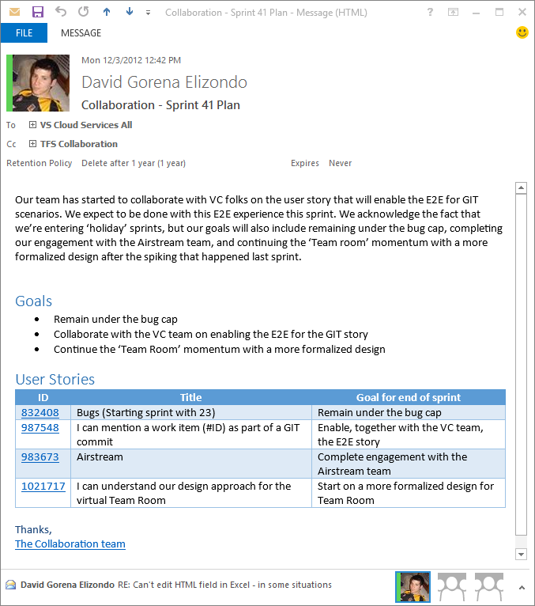
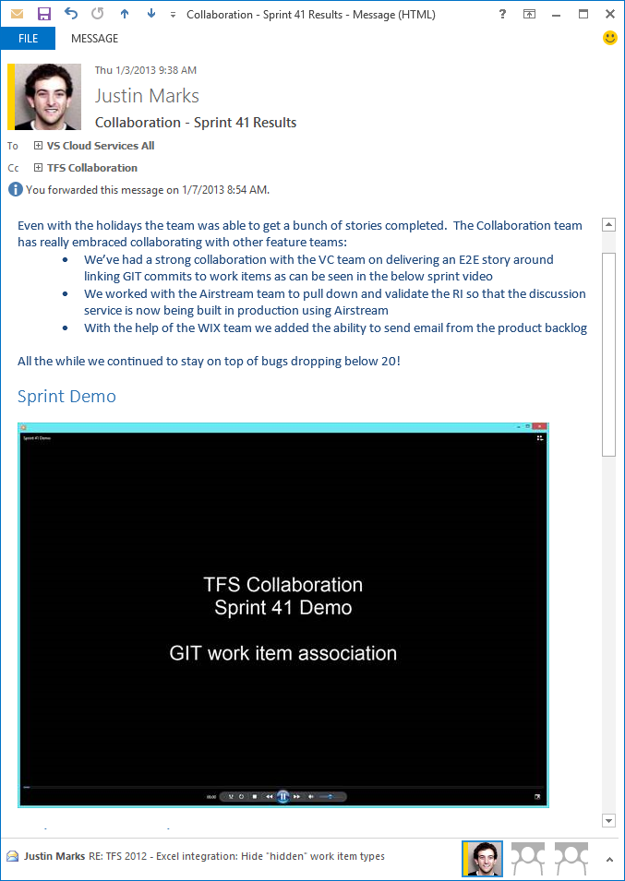
Sprint Mails - Example

Slide 15
Adopting Cloud Cadence
The Why?
Teams
Schedule
Ceremonies
Deployment
Practices
Live Site Culture
Business Success
Telemetry
Learning
Productizing

Slide 16
Deployment Principles
Always up
Fully automated
Decoupled services with clear contracts
Feature flags
Incremental (canary) deployment

Slide 17
Feature Flag Pattern
All code is deployed, but feature flags control exposure
Flags provide runtime control down to individual user
Users can be added or removed with no redeployment
Enables dark launch
Mechanism for progressive experimentation and refinement

Slide 18
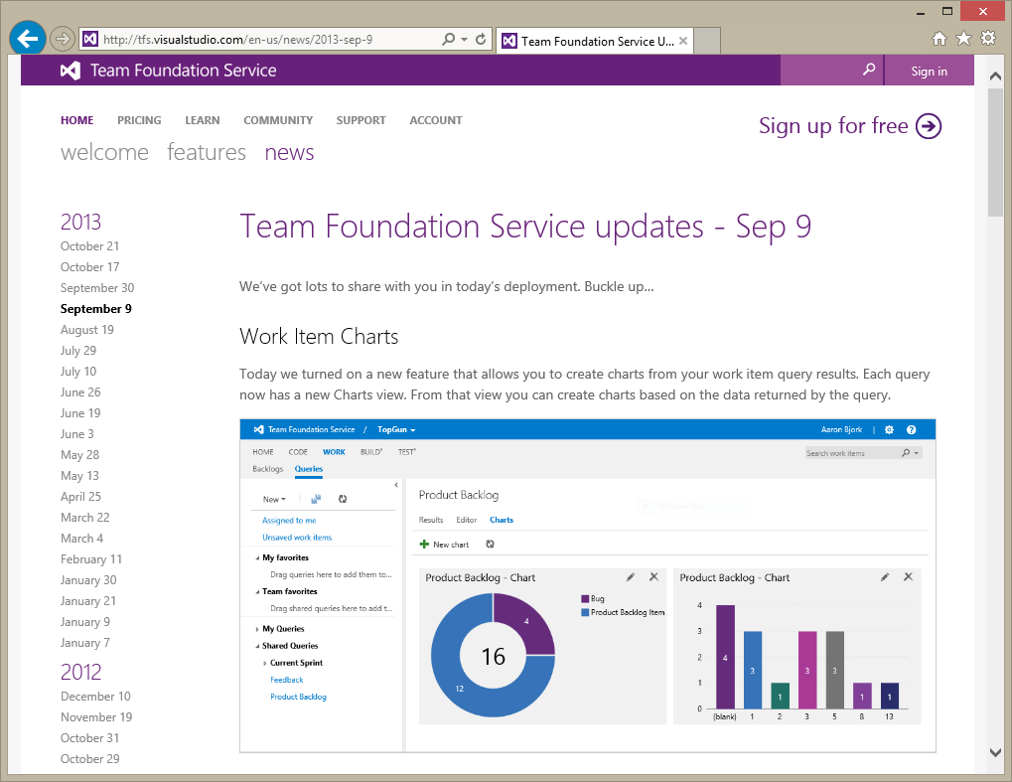
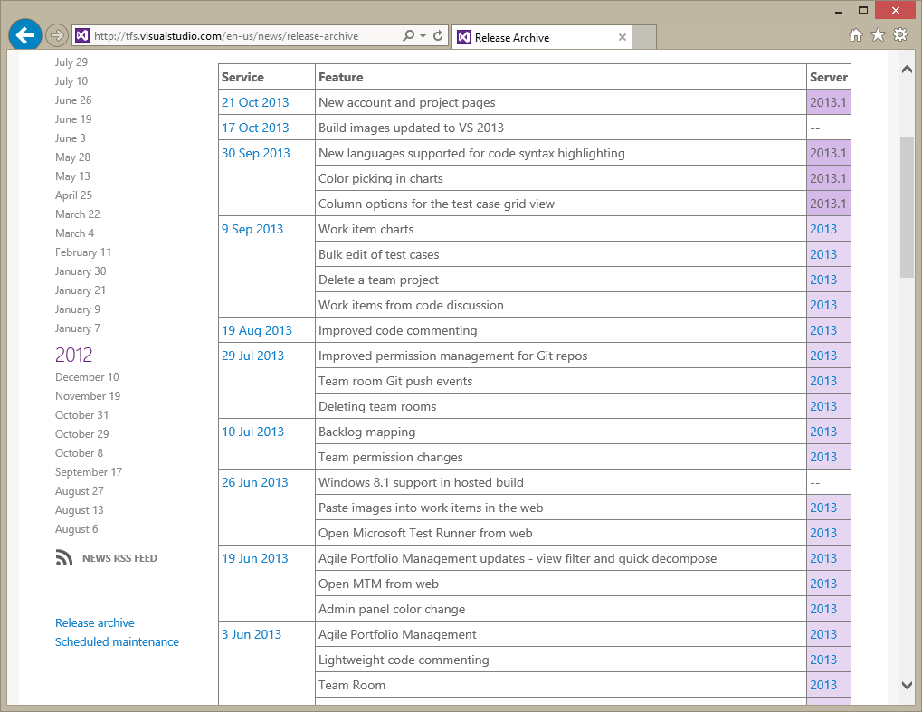
Frequent Updates
?
?
?
?
?
?
?
?
?
?
?
?
?
?
?
Notes:
We’ve now got channels for feedback continually. We still have the “big event” feedback at preview, etc. But we’ve got a channel to talk to customers… constantly.
In fact, to make that a bit more real… here are examples from our release notes that we write every 3 weeks with updates to our service. At each of these intervals we’ve got a chance to listen to customers and react.

Slide 19
Multiple Scale Units / DCs Enable Canarying
Shared Platform Services
DB
AT
JA
AT
JA
AT
JA
Chicago
TFS SU1
TFS SU0
TFS SU2
DB
DB
DB
AT
JA
AT
JA
AT
JA
AT
JA
AT
JA
AT
JA
AT
JA
AT
JA
AT
JA
Chicago
San Antonio
Amsterdam

Slide 20
Adopting Cloud Cadence
The Why?
Teams
Schedule
Ceremonies
Deployment
Practices
Live Site Culture
Business Success
Telemetry
Learning
Productizing

Slide 21
Live-site Culture Principles
Site status is always pri 1
Global response team
On-call DRI (Designated Responsible Individual) by area
Weekly live site review
Monthly service review
Live-site issues become product backlog items

Slide 22
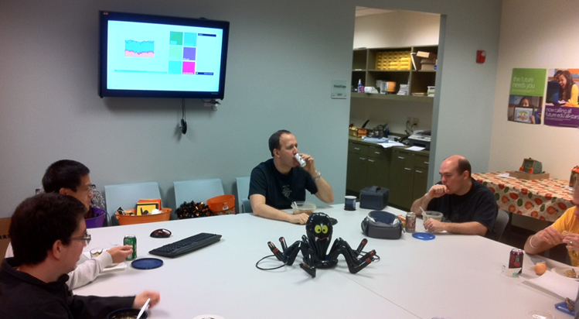
Dashboards Always Visible

Slide 23
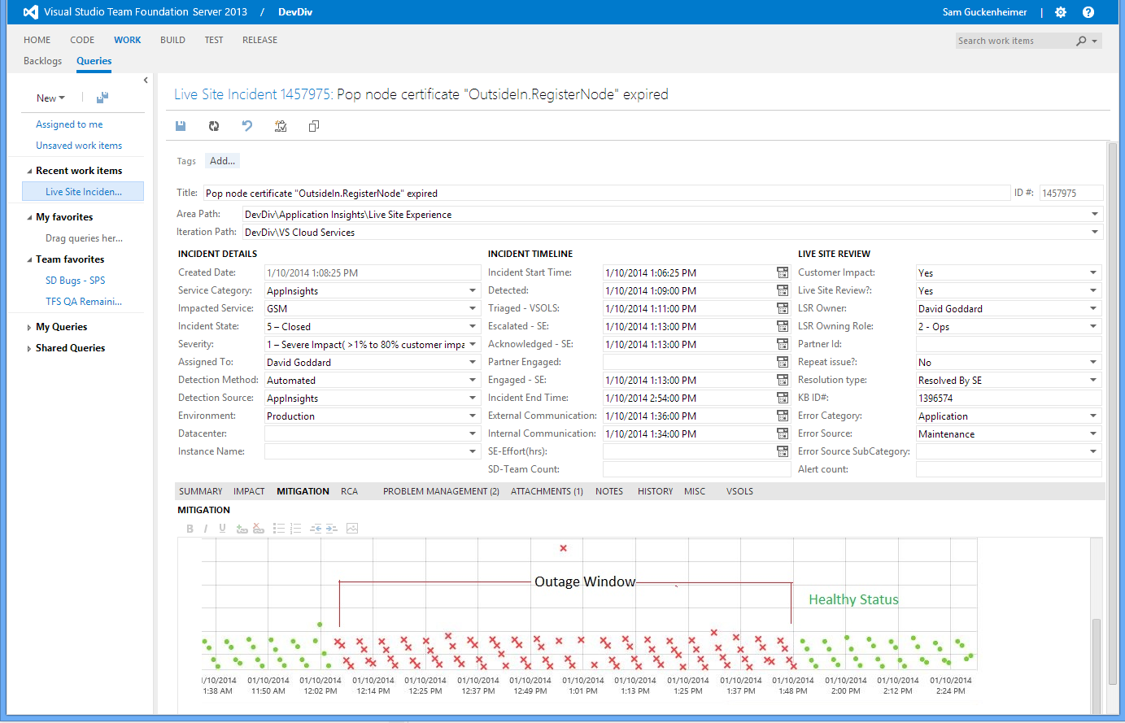
Live Site Issues (LSIs)

Slide 24
Adopting Cloud Cadence
The Why?
Teams
Schedule
Ceremonies
Deployment
Practices
Live Site Culture
Business Success
Telemetry
Learning
Productizing

Slide 25
Driving Business Success
“Top Customer” program
Customer contact
Monthly service review
Experimentation, or Build-Measure-Learn

Slide 26
Every Service has Multiple Funnels
Feeding the mouth of the funnel might be a vanity metric, if conversion rates decrease.
Think of each progression and its hassle map to expand funnel efficiency.
Experiment!
Check-In / Push
Created a Project
Build
Created an Account
Deployed
 | August | September | October | November | December | January*
Accounts Created
Projects Created
Code Checked-In
Builds Executed
Deployments to Azure
 | August | September | October | November | December | January*
Account -> Project
Project -> Check-In
Check-In -> Build
Build -> Deploy
E2E Conversion

Slide 27
Track MoM Growth Rates (not just Cumulative)
Launch
MoM Growth in [sub]Service Adoption
Notes:
ELS Active accounts based on 60 days activities are:
Sep-13 to Jan 14: 194, 263, 343, 400, 459

Slide 28

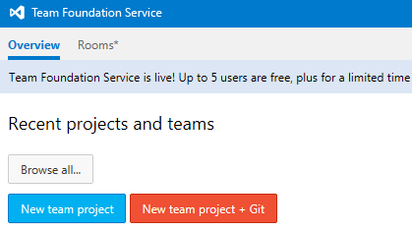
Build, Measure, Learn
Build
Measure
We had this…
30%
Learn
… we decided we could do better, and made a few changes
Notes:
For the success of features we’re investing in a “Build, Measure, Learn” culture.
<talk about BML>
Let me give you a recent example…

Slide 29
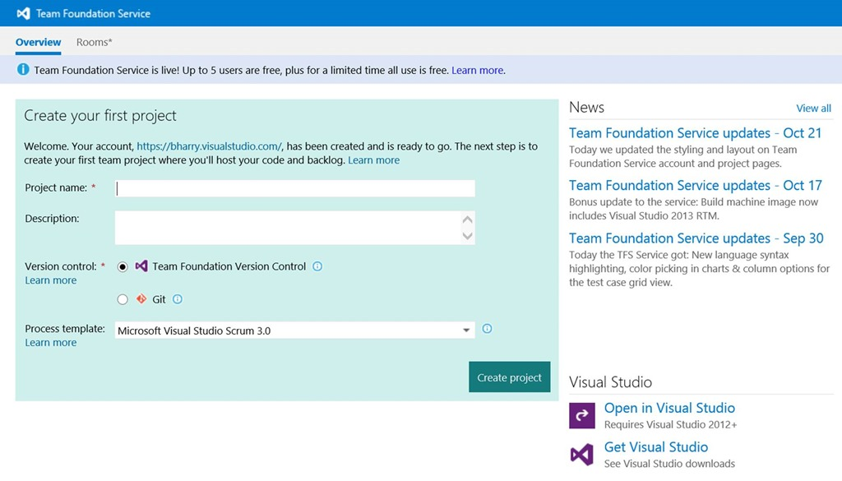
Build, Measure, Learn
Build
Measure
So we did this…
50%
+20% increase

Slide 30
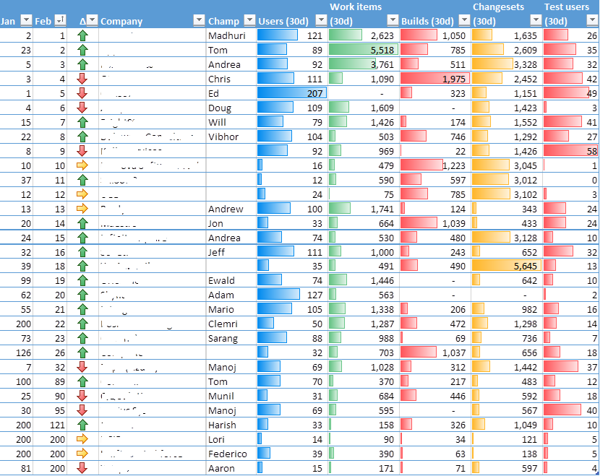
Top Customers Contacted by Reach-Out

Slide 31
Adopting Cloud Cadence
The Why?
Teams
Schedule
Ceremonies
Deployment
Practices
Live Site Culture
Business Success
Telemetry
Learning
Productizing

Slide 32
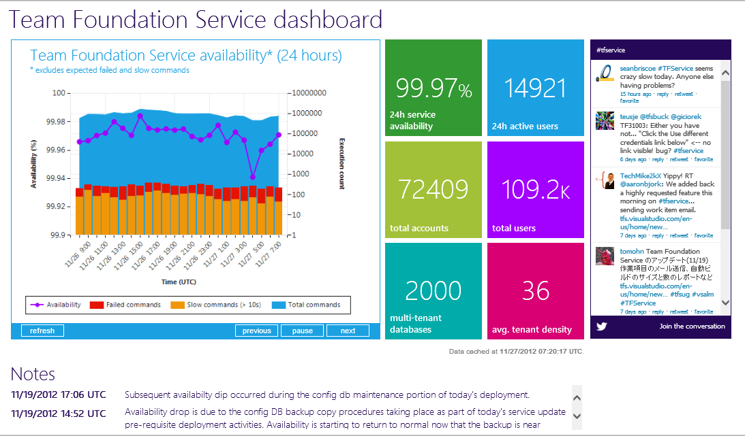
Gather everything
Monitor telemetry
Rootcauseevery issue
Maintain redundant paths
Telemetry Priniciples

Slide 33
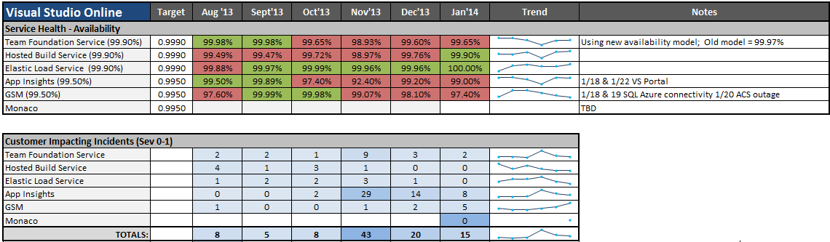
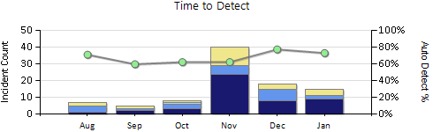
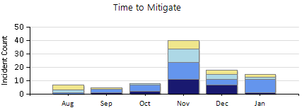
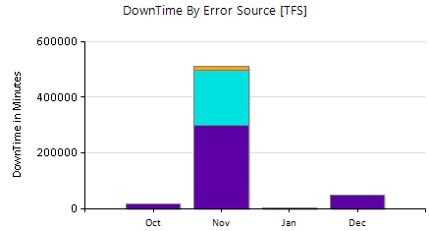
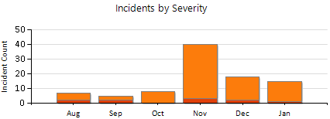
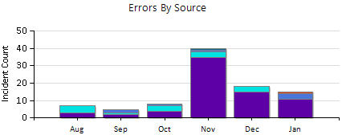
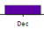
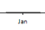
Service Availability& Operational Metrics
TFS availability was impacted by S59 deployment
Moving to regular deployment schedule from S61.
AI LSI trend is improving
Added Monaco
DRAFT
DRAFT
DRAFT
Notes:
Nov: restated # TFS tickets. Team did problem management and broke down general LSI tickets to specific events
Availability model: Outside in views not shown due to noise in current tests.
Outside of our control – customers network bandwidth, working towards measuring to the Time to First byte sent Vs., total time. Total time is usually bad if customer network bandwidth is poor
AI Availability Model: Multi-step synthetic transaction test covers more surface area, includes more steps and is more sensitive to customer experience. 10 E2E scenario tests cover full surface area, new model aggregates availability across all these tests. Example sensitive measures: Single PoP node failures, data latency issues all count against availability model – these were not part of Gomez before. Availability model continues to be refined as new scenarios are uncovered.

Slide 34
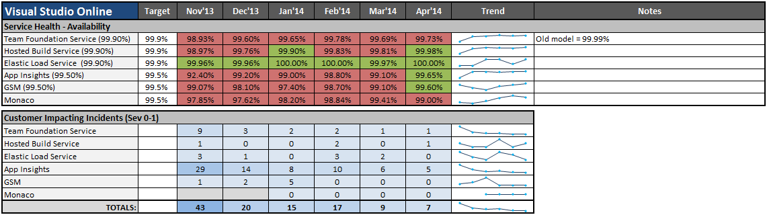
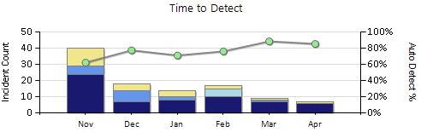
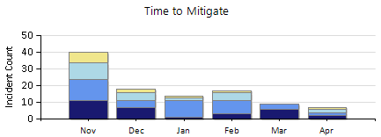
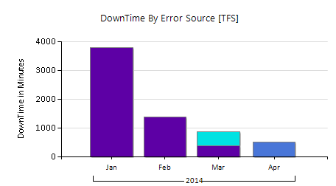
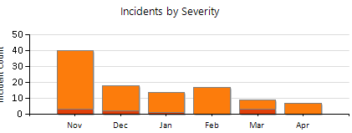
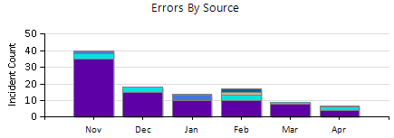
Service Availability & Operational Metrics
Overall decline in month-over-month incidents
Uneventful //build launch
App Insights Sev0/1 declining but Sev2 have increased
DRAFT
DRAFT
Notes:
“Monaco Availability - Server reliability will increase after handling file errors gracefully. Starting in May, Monaco informs the user with a failure and allow them to take action on it. “
Build availability impact detail:
We had a customer issue (genbamanager) where the customer had created a build definition that caused the builds to fail. Because of how these builds failed they were represented as Outcome 1 (infrastructure related, SLA impacting) in HB even though these are customer controlled build failures which should not impact SLA. Dev is fully aware of the situation (Bug 1512882) and it took a number of days to identify the issue, see that it wasn’t a short term issue, get ahold of the customer to remedy the issue. We could have disabled the customer’s controller to stop the failed builds from running, however we decided to take the artificial SLA impact over the real customer impact as they had other builds that were succeeding without issue.
The customer has the build controller custom assembly path set to team project root ($/genbamanager2) which is not recommended. They should set this path to a folder that contains just the custom assemblies as we try to download everything under the path specified. This is a limitation on our end but please ask the customer to review their custom assembly path. That will help them also as they will have more successful build.
Availability model: Outside in views not shown due to noise in current tests.
Outside of our control – customers network bandwidth, working towards measuring to the Time to First byte sent Vs., total time. Total time is usually bad if customer network bandwidth is poor
AI Availability Model: Multi-step synthetic transaction test covers more surface area, includes more steps and is more sensitive to customer experience. 10 E2E scenario tests cover full surface area, new model aggregates availability across all these tests. Example sensitive measures: Single PoP node failures, data latency issues all count against availability model – these were not part of Gomez before. Availability model continues to be refined as new scenarios are uncovered.

Slide 35
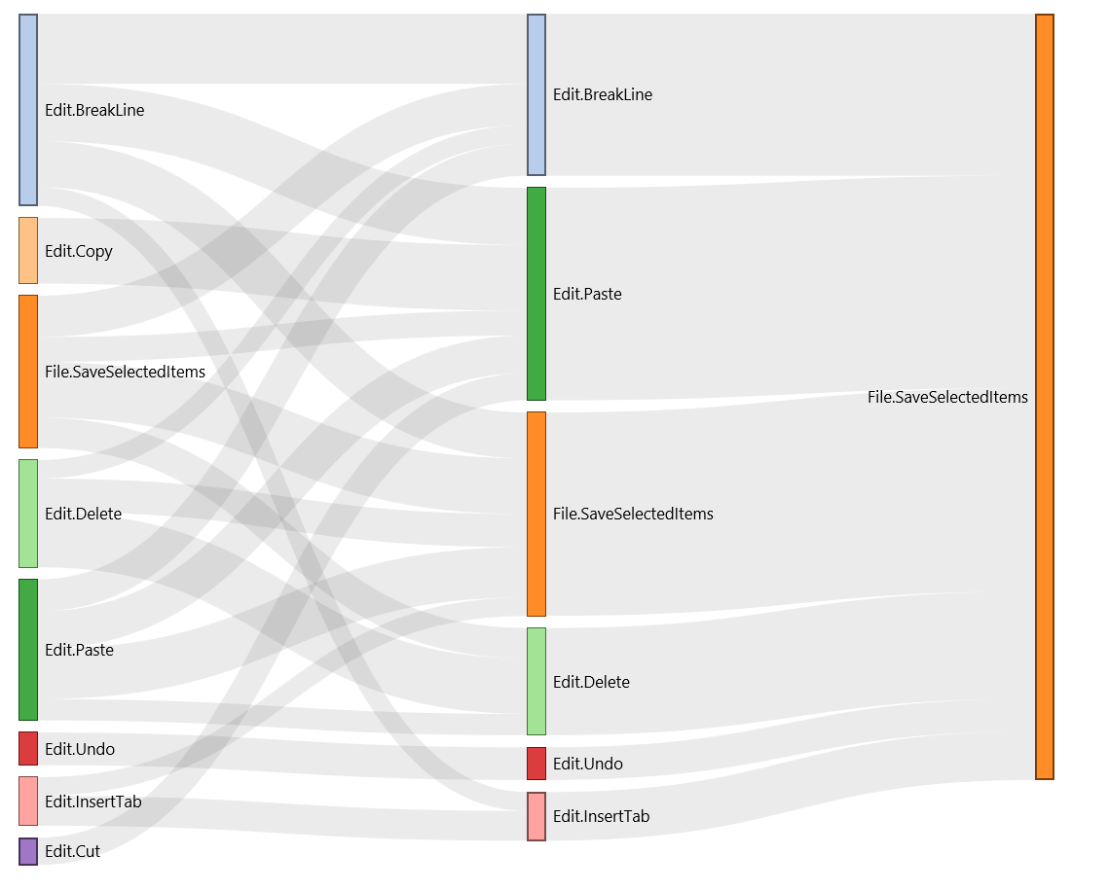
Dashboard Mockups - Usage Patterns
Based on Tools Window activations
Easy to combine with Command data
Can be broken out/filtered by any of the common slicers (SKU, Release, Language, OS, etc.)
Solution Explorer
Class View
Team Explorer
Team Explorer
Web Browser Window
Class View
FindReplace
Web Browser Window
FindReplace
UML Model Explorer
UML Model Explorer
Code Metrics
Code Analysis
FindReplace
Code Metrics
Code Analysis

Slide 36
Adopting Cloud Cadence
The Why?
Teams
Schedule
Ceremonies
Deployment
Practices
Live Site Culture
Business Success
Telemetry
Learning
Productizing

Slide 37
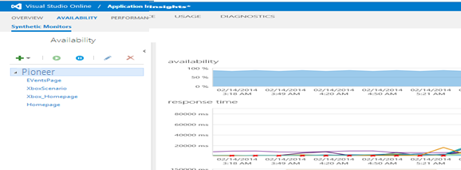
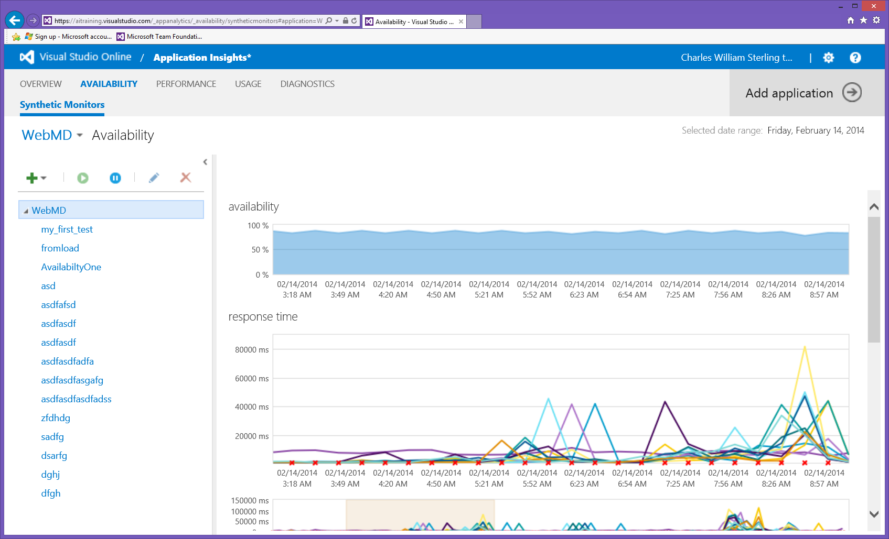
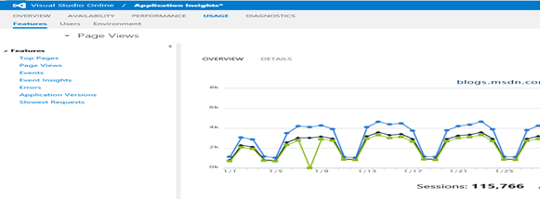
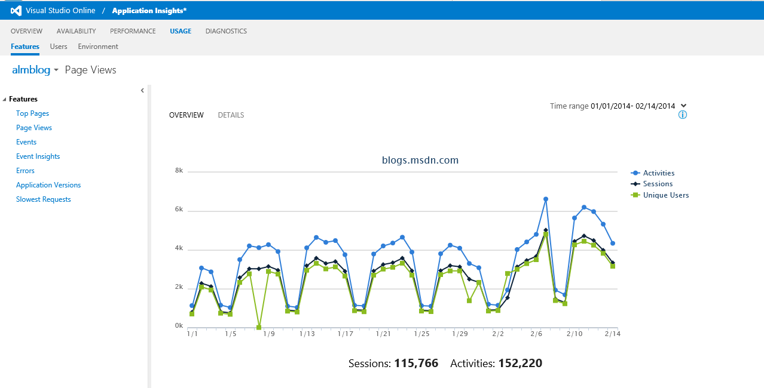
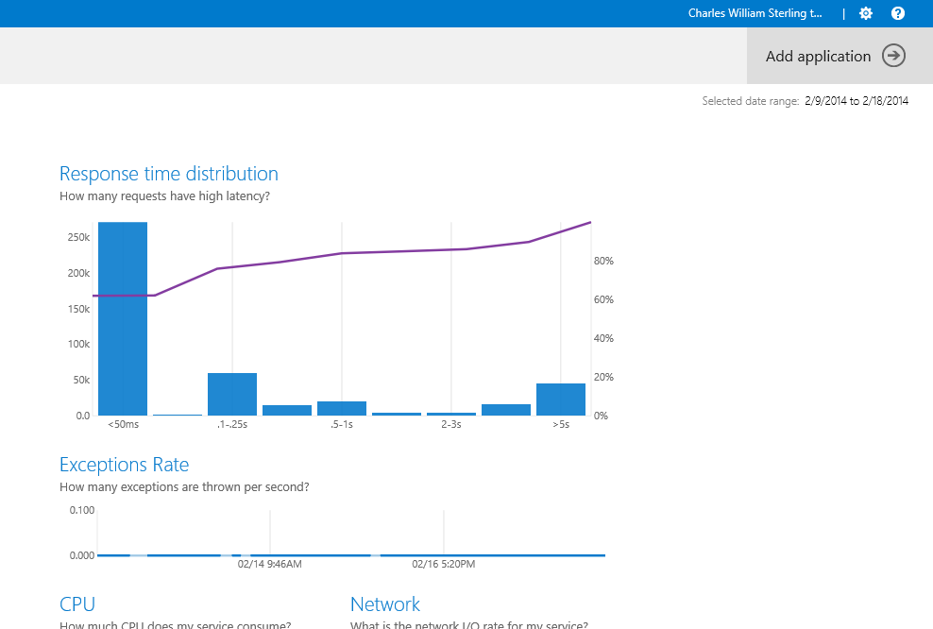
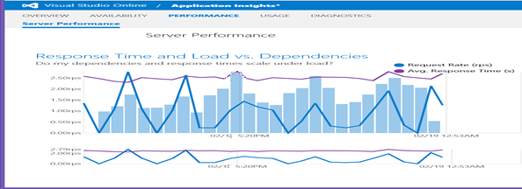
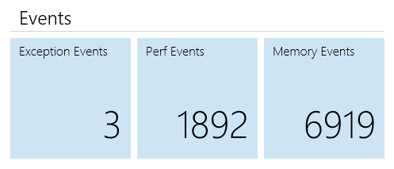
Available
Available
Successful
Application Insights
Performant

Slide 38
Adopting Cloud Cadence
The Why?
Teams
Schedule
Ceremonies
Deployment
Practices
Live Site Culture
Business Success
Telemetry
Learning
Productizing

Slide 39
Dimensions of Practice
Are these the dimensions you see? How do you assess improvement?
Agile Schedule and Team
Production First
Flow of Value
Hypothesis-based Backlog
Evidence and Data
Public / Hybrid Cloud
Managed Technical Debt

Slide 40

There’s No Place Like Production
http://erikasaca.files.wordpress.com/2011/03/ruby-red-slippers2.jpg

Slide 41
© 2013 Microsoft Corporation. All rights reserved. Microsoft, Windows, Windows Vista and other product names are or may be registered trademarks and/or trademarks in the U.S. and/or other countries.
The information herein is for informational purposes only and represents the current view of Microsoft Corporation as of the date of this presentation. Because Microsoft must respond to changing market conditions, it should not be interpreted to be a commitment on the part of Microsoft, and Microsoft cannot guarantee the accuracy of any information provided after the date of this presentation. MICROSOFT MAKES NO WARRANTIES, EXPRESS, IMPLIED OR STATUTORY, AS TO THE INFORMATION IN THIS PRESENTATION.

